Slide 1
24
7
30
Title: Surds
EQ : What are surds?
Question:
Notes:
Surds are numbers left in square root form or cubed root form etc.
Surds are irrational numbers because we do not know their exact value.
Surds are left in n-th root form because it is more accurate than writing them as a decimal.
17

Slide 2
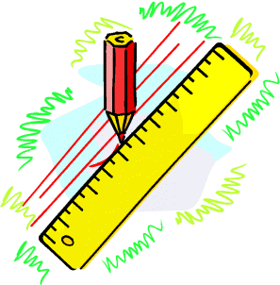


What is a Surd
= 6
= 12
The above roots have exact values
and are called rational
$$≈1.4142356…..$$
$$≈2.785924…..$$
These roots do NOT have exact values
and are called irrational OR
Surds

Slide 3

24
7
30
Title: Surds
EQ : What are surds?
Question:
Notes:
Surd Rules:
$$\sqrt{xy}= \sqrt{x} × \sqrt{y}$$
Example:
$$\sqrt{12}= \sqrt{4} × \sqrt{3}$$
$$=2\sqrt{3}$$
To simplify √12 we must split 12 into factors with at least one being a square number.
Now simplify the square root.
17

Slide 4
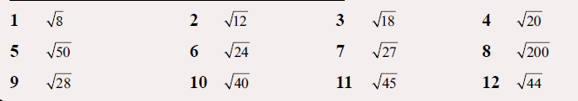

Slide 5
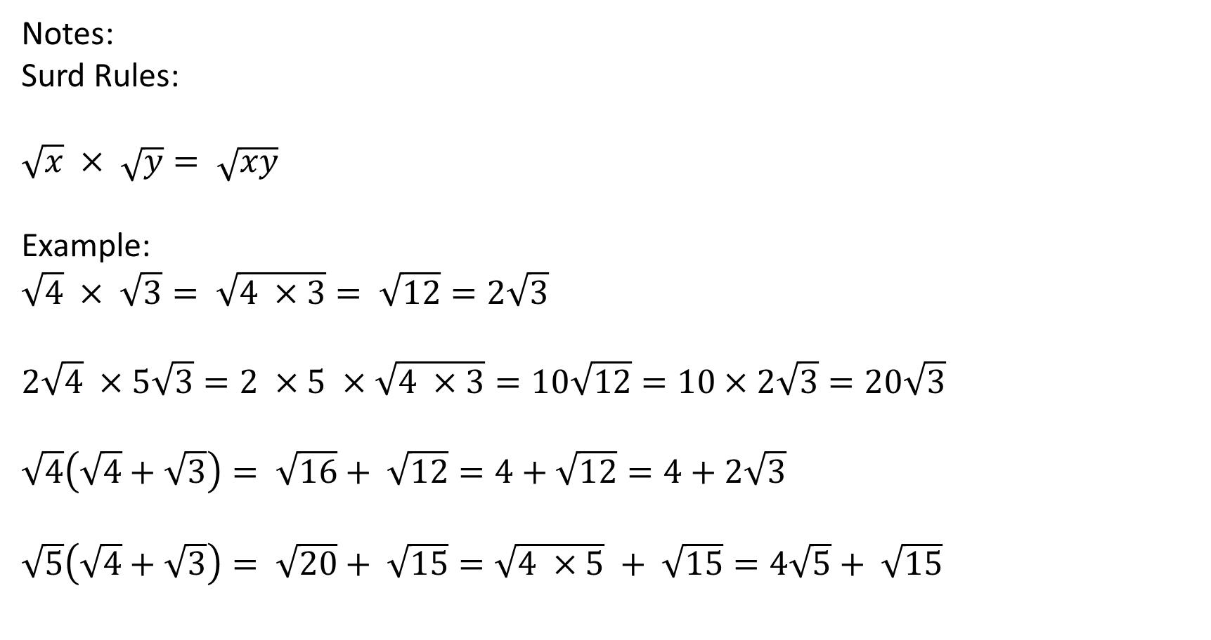
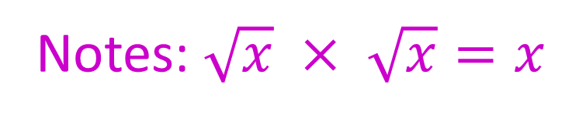
24
7
30
Title: Surds
EQ : What are surds?
Question:
Notes:
Surd Rules:
$$\sqrt{x} × \sqrt{y}= \sqrt{xy}$$
Example:
$$\sqrt{4} × \sqrt{3}= \sqrt{4 ×3}= \sqrt{12}=2\sqrt{3}$$
$$2\sqrt{4} ×5\sqrt{3}=2 ×5 ×\sqrt{4 ×3}=10\sqrt{12}=10×2\sqrt{3}=20\sqrt{3}$$
$$\sqrt{4}\left(\sqrt{4}+\sqrt{3}\right)= \sqrt{16}+ \sqrt{12}=4+\sqrt{12}=4+2\sqrt{3}$$
$\sqrt{5}\left(\sqrt{4}+\sqrt{3}\right)= \sqrt{20}+ \sqrt{15}=\sqrt{4 ×5} + \sqrt{15}=4\sqrt{5}+ \sqrt{15}$
Notes: $\sqrt{x} × \sqrt{x}=x$
17

Slide 6
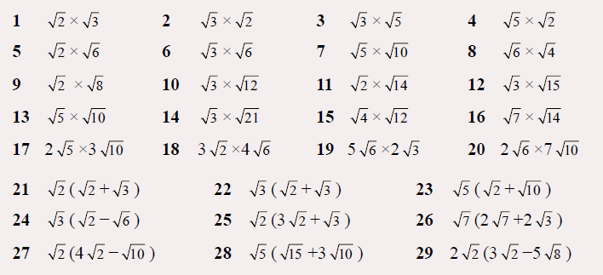

Slide 7

Title: Surds
EQ : What are surds?
Question:
Notes:
Surd Rules:
$$a\sqrt{x}+b\sqrt{x}=(a+b)\sqrt{x}$$
$$a\sqrt{x}−b\sqrt{x}=(a−b)\sqrt{x}$$
Example:
10$\sqrt{3}+5\sqrt{3}=15\sqrt{3}$
$$\sqrt{5} −8+7\sqrt{5}=8\sqrt{5 } −8$$
7$\sqrt{3}−5\sqrt{12}=7\sqrt{3} −5\sqrt{3×4}=7\sqrt{3}−5×2\sqrt{3}=7\sqrt{3}−10\sqrt{3}=−3\sqrt{3}$
Because a surd such as √2 cannot be calculated exactly it can be treated in the same way as an “x” variable in algebra. The following examples will illustrate this point.
Uses the same process as collecting like terms!!!!
17

Slide 8
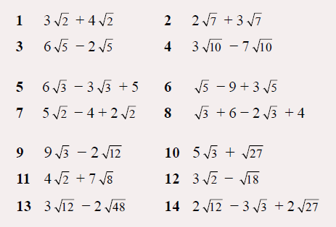

Slide 9
Rules of surds
We can divide surds
in general
Note that this works both ways

Slide 10
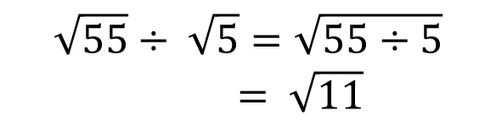
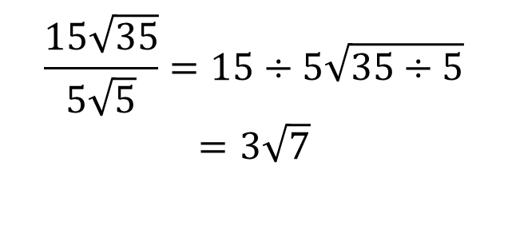

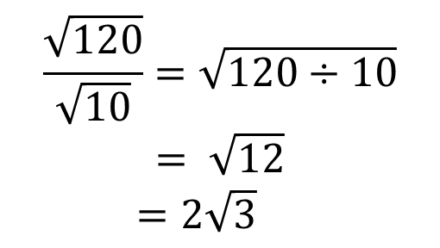
Title: Surds
EQ : What are surds?
Question:
Examples:
$$\frac{9\sqrt{88}}{6\sqrt{99}}=\frac{9\sqrt{8}}{6\sqrt{9}}$$
$$=\frac{9×2\sqrt{2}}{6×3}$$
$$=\frac{18\sqrt{2}}{18}$$
$= \sqrt{2}$
$$\sqrt{55}÷ \sqrt{5}=\sqrt{55÷5}$$
$= \sqrt{11}$
$$\frac{\sqrt{120}}{\sqrt{10}}=\sqrt{120÷10}$$
$$= \sqrt{12}$$
$=2\sqrt{3}$
$$\frac{15\sqrt{35}}{5\sqrt{5}}=15÷5\sqrt{35÷5}$$
$$=3\sqrt{7}$$
17

Slide 11
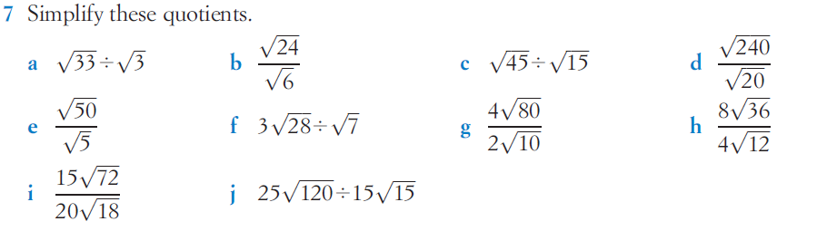

Slide 12

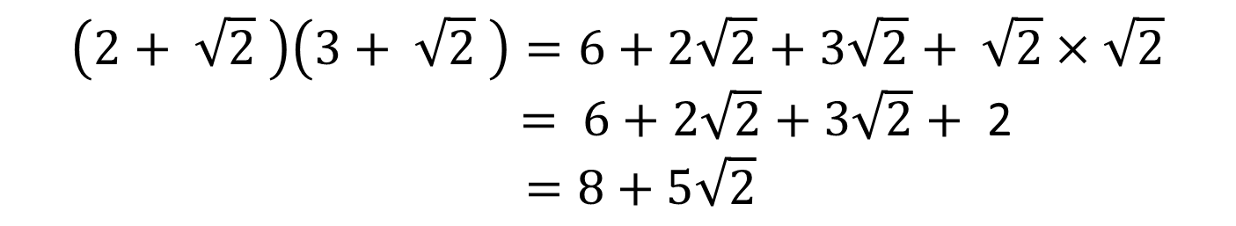
Title: Surds
EQ : What are surds?
Question:
Notes:
Expanding double brackets:
$$\left(2+ \sqrt{2} \right)\left(3+ \sqrt{2} \right)=6+2\sqrt{2}+3\sqrt{2}+ \sqrt{2}×\sqrt{2}$$
$= 6+2\sqrt{2}+3\sqrt{2}+$ 2
$$=8+5\sqrt{2}$$
17

Slide 13
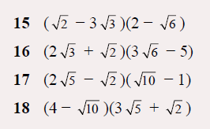

Slide 14




Title: Surds
EQ : What are surds?
Question:
Conjugate Pairs:
Consider the expression below:
This is a conjugate pair. The brackets are identical apart from the sign in each bracket .
Now observe what happens when the brackets are multiplied out:
$$\left(\sqrt{3}+6\right)\left(\sqrt{3} −6\right)=$$
$$\sqrt{3} ×\sqrt{3}−6\sqrt{3}+6\sqrt{3} −36$$
$$=3 −36$$
$$=−33$$
When the brackets are multiplied out the surds ALWAYS cancel out and we end up seeing that the expression is rational .

Slide 15
